Slide 1
Getting Started with MODFLOW 6
Introduction to Groundwater Modeling using MODFLOW

Slide 2
Outline
Workflow
What’s in the distribution
Simulation
Temporal discretization
Numerical Solution
Groundwater Flow (GWF) Model

Slide 3
What is MODFLOW?
A computer program for hydrologic simulation (traditionally groundwater flow)
Command line executable program
Runs on Windows, Mac, and Linux
Written in Fortran (MODFLOW 6 is object oriented)
Reads text and binary input files
Writes text and binary output files

Slide 4
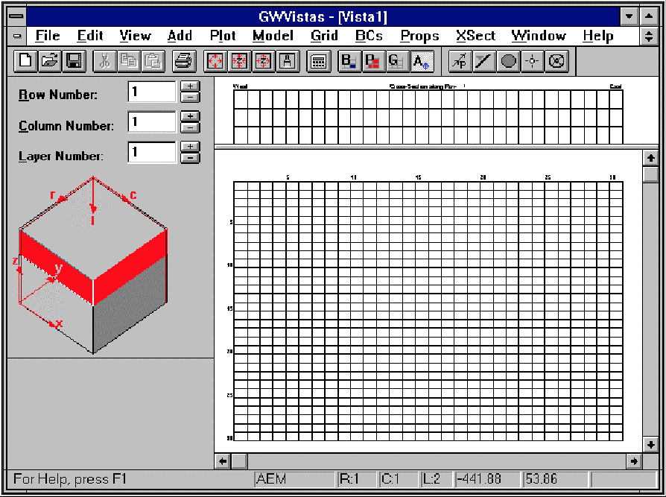
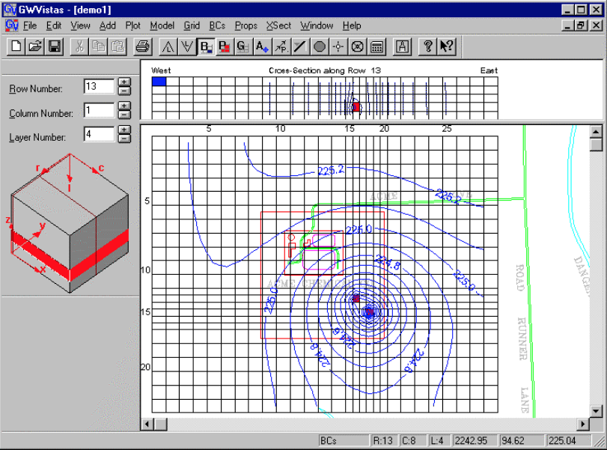
MODFLOW Simulation Workflow
Graphical User Interface
(GUI)
or
FloPy
Input Files
Output Files
MODFLOW Program

Slide 5
MODFLOW Simulation Workflow
Input Files
Output Files
MODFLOW Program
Much of the focus of this class will be on this part of the workflow

Slide 6
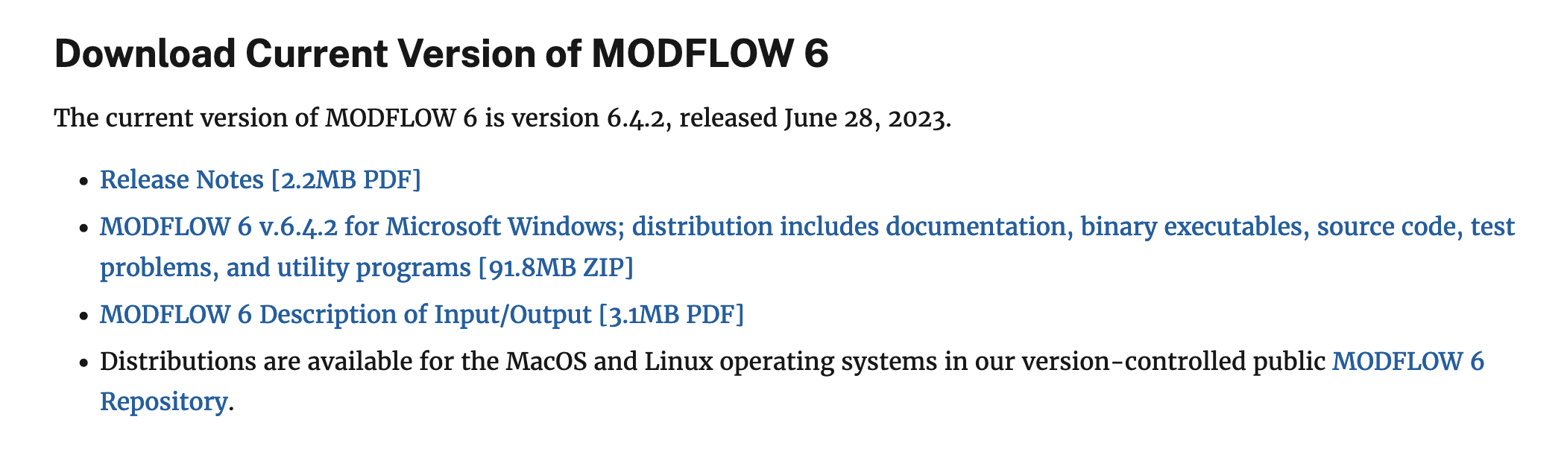
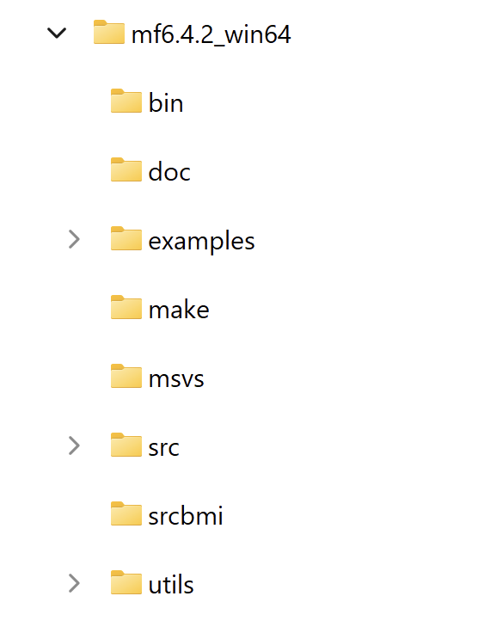
MODFLOW 6 Distribution
Zip file available from USGS website
Unzipped

Slide 7
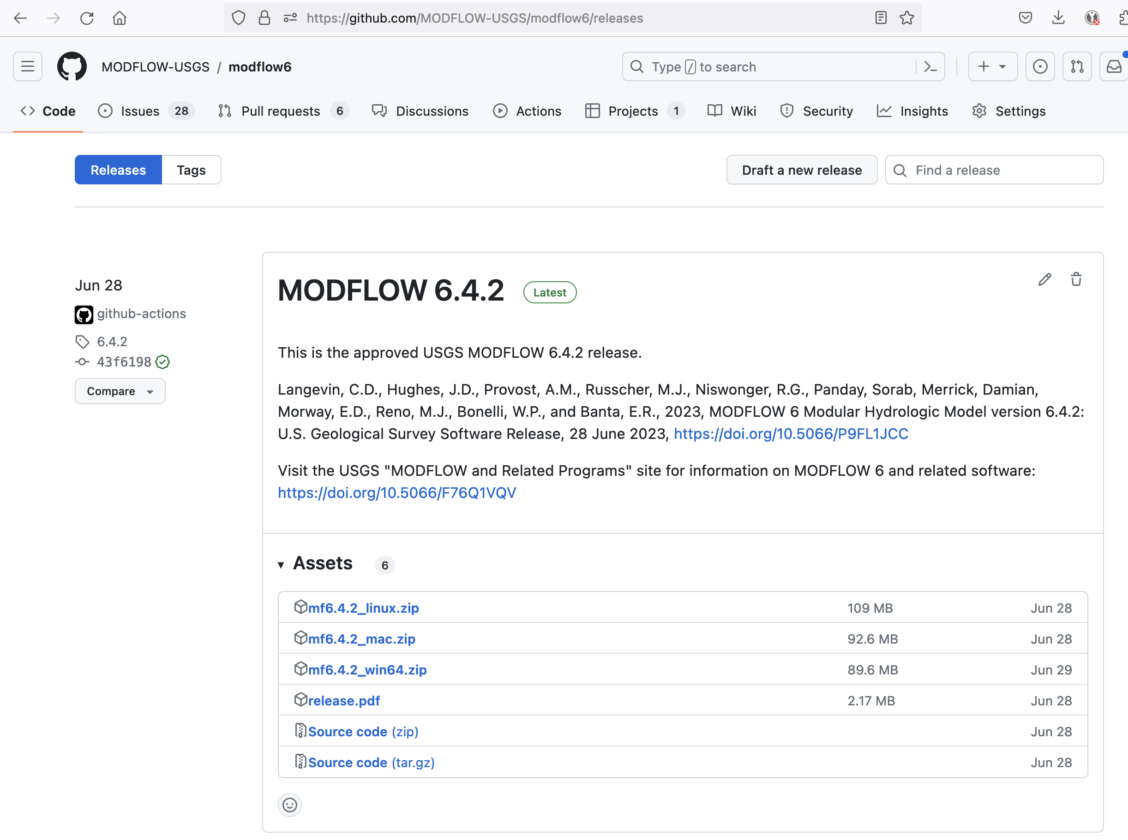
Github Releases
https://github.com/MODFLOW-USGS/modflow6/releases

Slide 8
Distribution Content

Slide 9
Distribution Content
bin
mf6 (exe and dll)
mf5to6 (converter mf2005 to mf6)
zbud6 (ZONEBUDGET program)
doc
Release notes
Input and output guide
Supplemental technical information
Example description
Reports
examples
Lots and lots of examples…

Slide 10
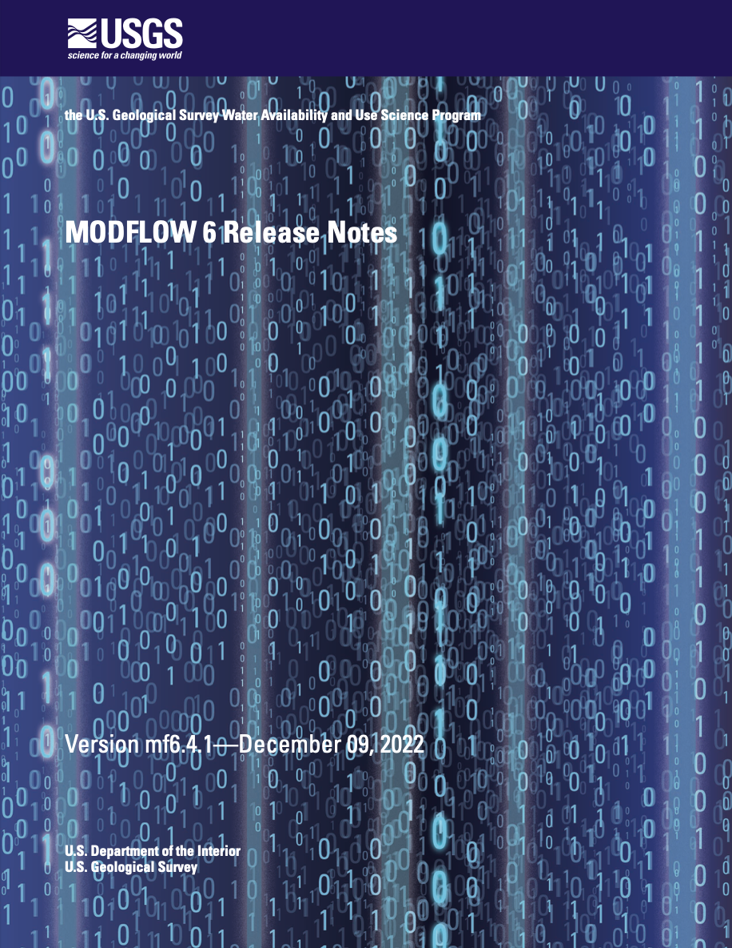
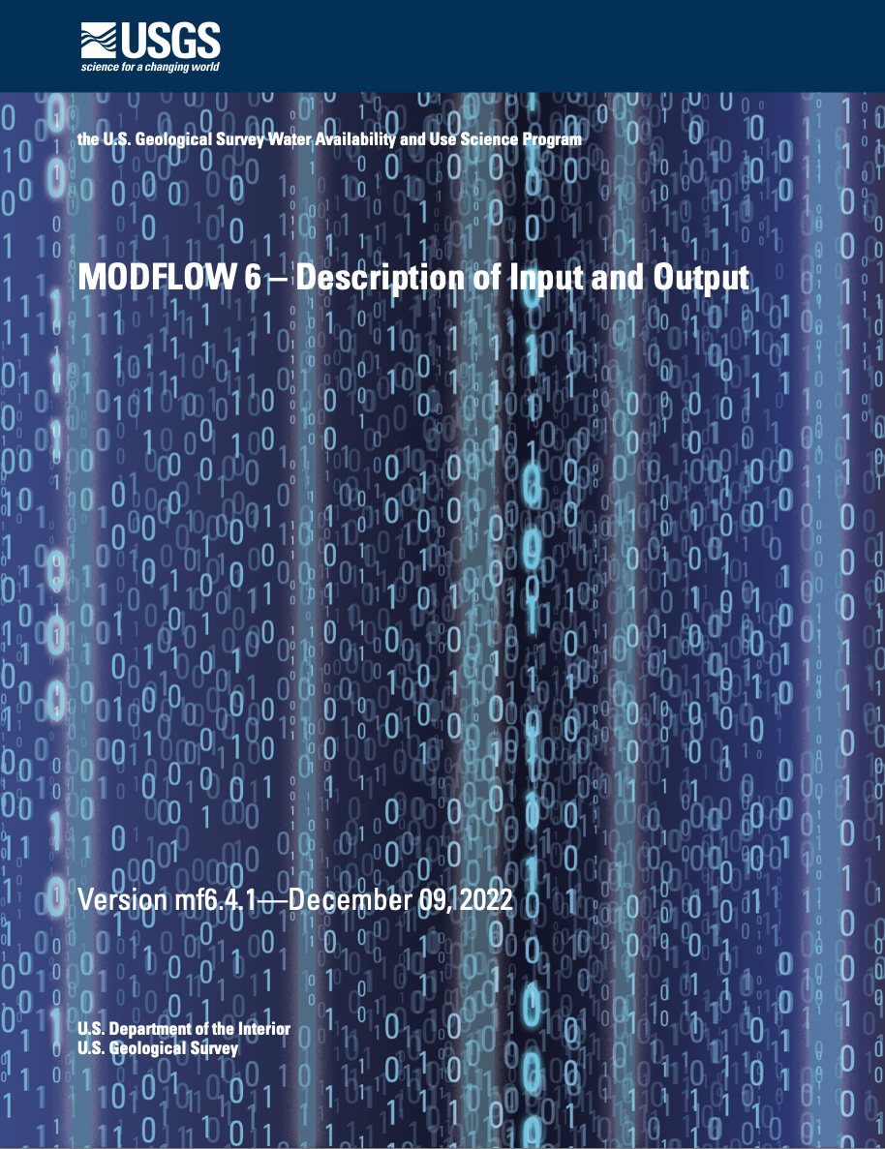
Important User Information

Slide 11
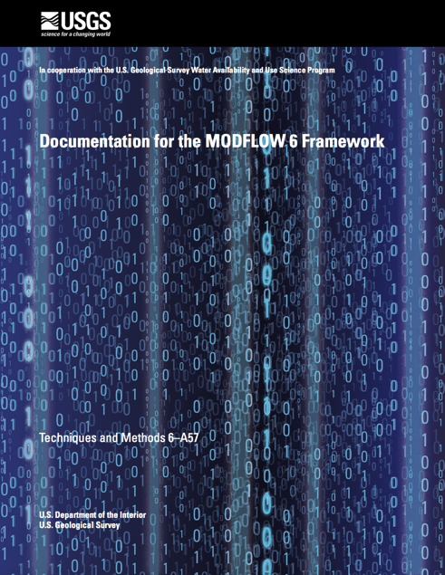
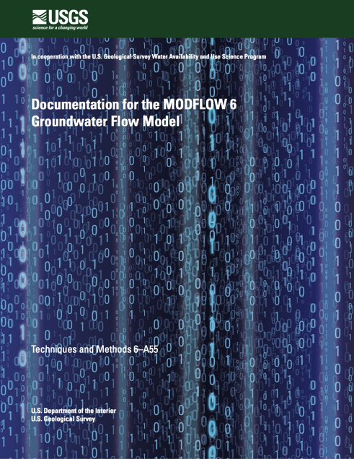
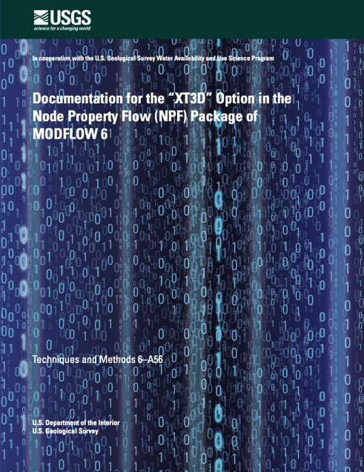
MODFLOW 6 Publications
Hughes, J.D., Langevin, C.D., and Banta, E.R., 2017, Documentation for the MODFLOW 6 framework: U.S. Geological Survey Techniques and Methods, book 6, chap. A57, 40 p., https://doi.org/10.3133/tm6A57.
Langevin, C.D., Hughes, J.D., Banta, E.R., Niswonger, R.G., Panday, Sorab, and Provost, A.M., 2017, Documentation for the MODFLOW 6 Groundwater Flow Model: U.S. Geological Survey Techniques and Methods, book 6, chap. A55, 197 p., https://doi.org/10.3133/tm6A55.
Provost, A.M., Langevin, C.D., and Hughes, J.D., 2017, Documentation for the "XT3D" option in the Node Property Flow (NPF) Package of MODFLOW 6: U.S. Geological Survey Techniques and Methods, book 6, chap. A56, 40 p., https://doi.org/10.3133/tm6A56.

Slide 12
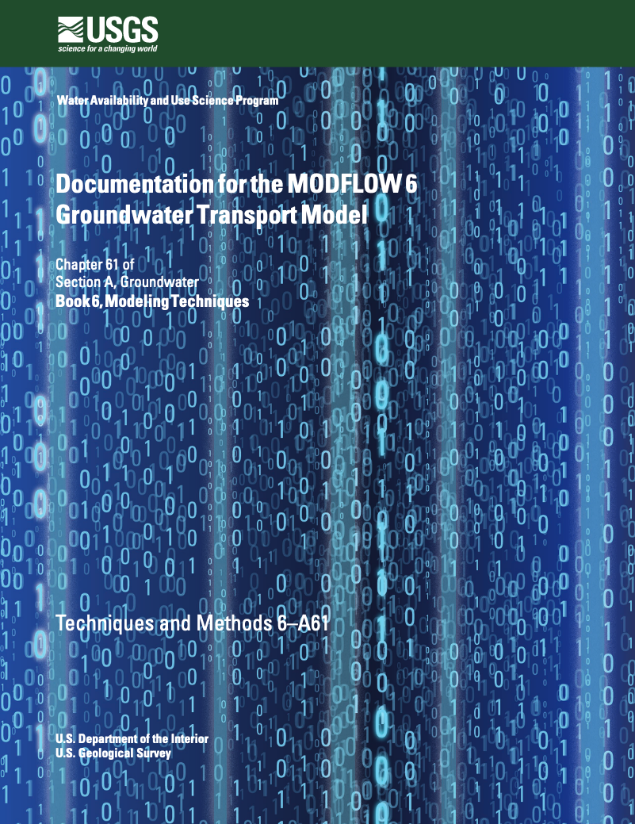
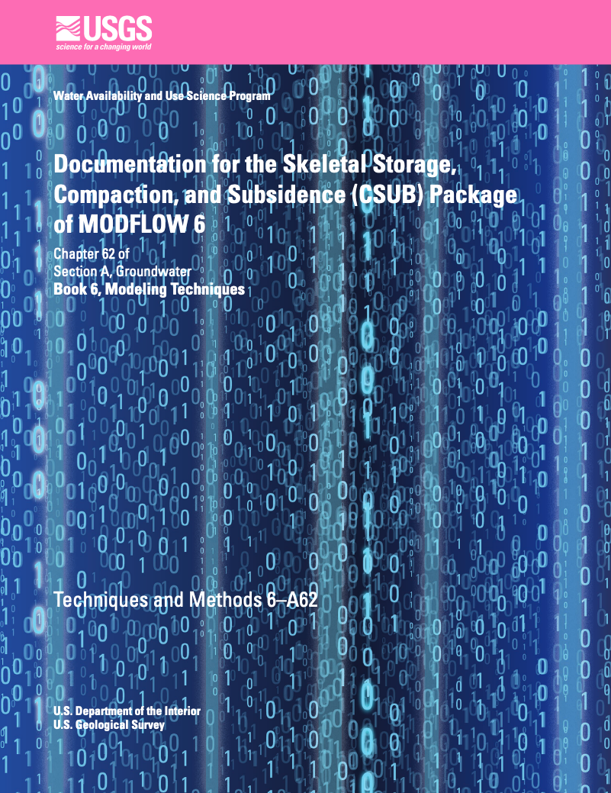
MODFLOW 6 Publications (cont)
Langevin, C.D., Provost, A.M., Panday, Sorab, and Hughes, J.D., 2022, Documentation for the MODFLOW 6 Groundwater Transport Model: U.S. Geological Survey Techniques and Methods, book 6, chap. A61, 56 p., https://doi.org/10.3133/tm6A61.
Hughes, J.D., Leake, S.A., Galloway, D.L., and White, J.T., 2022, Documentation for the Skeletal Storage, Compaction, and Subsidence (CSUB) Package of MODFLOW 6: U.S. Geological Survey Techniques and Methods, book 6, chap. A62, 57 p., https://doi.org/10.3133/tm6A62.

Slide 13

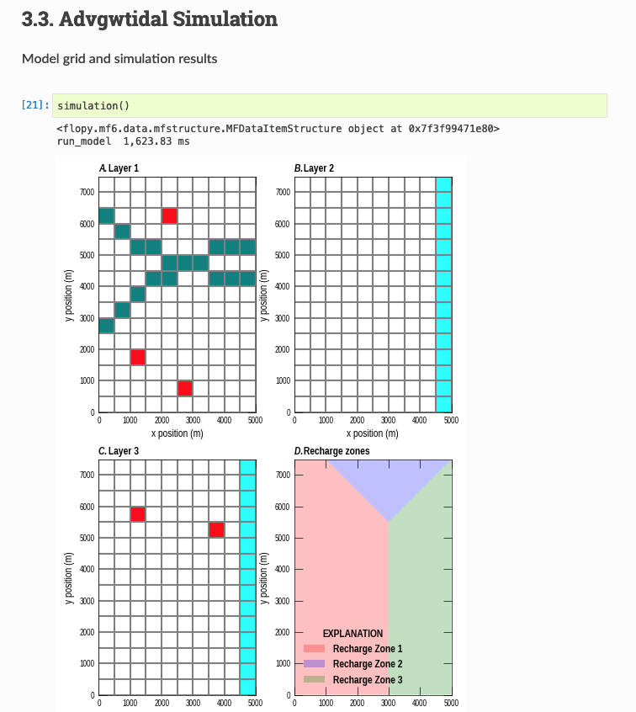
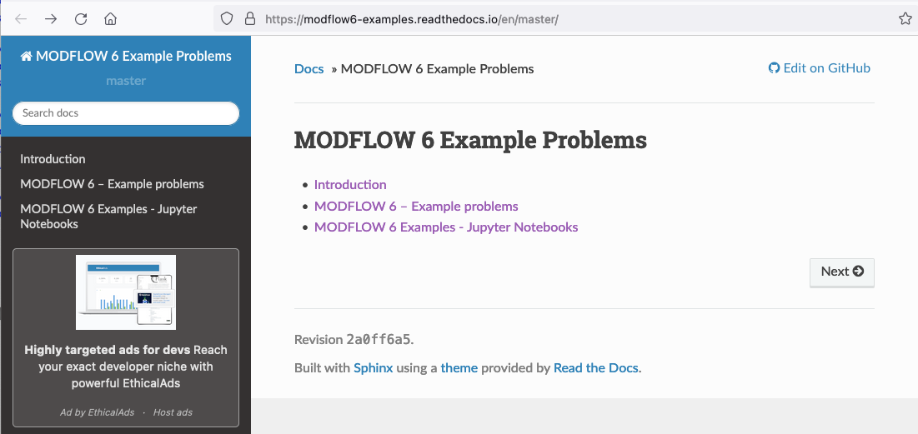
Examples
56 example problems
Described in mf6examples.pdf
Described in online document
All examples available as FloPy scripts

Slide 14
Simulation

Slide 15
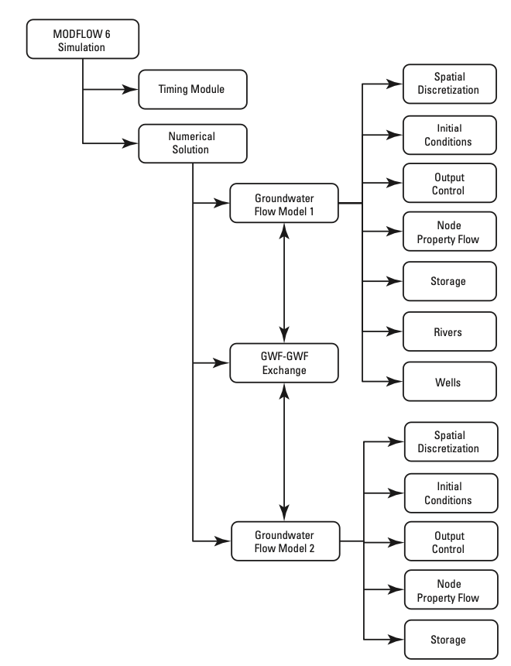
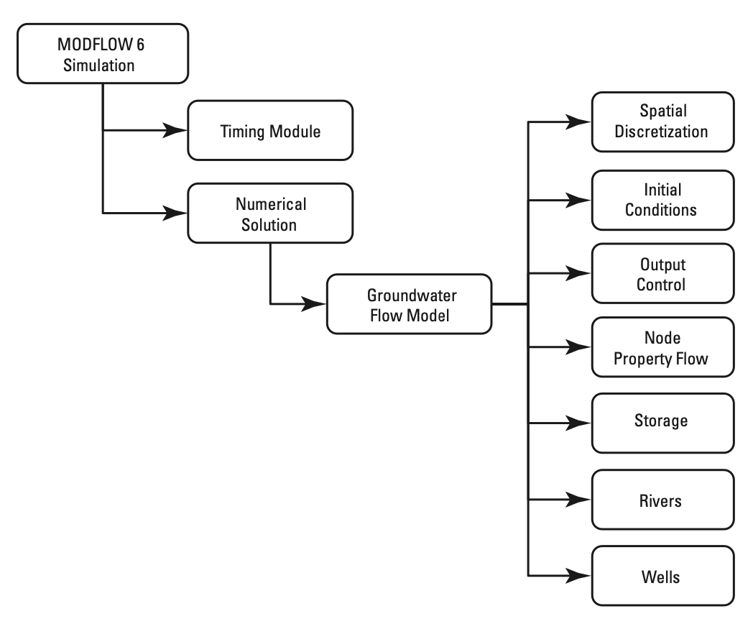
Simulation Types
Single Model
Multiple Models

Slide 16
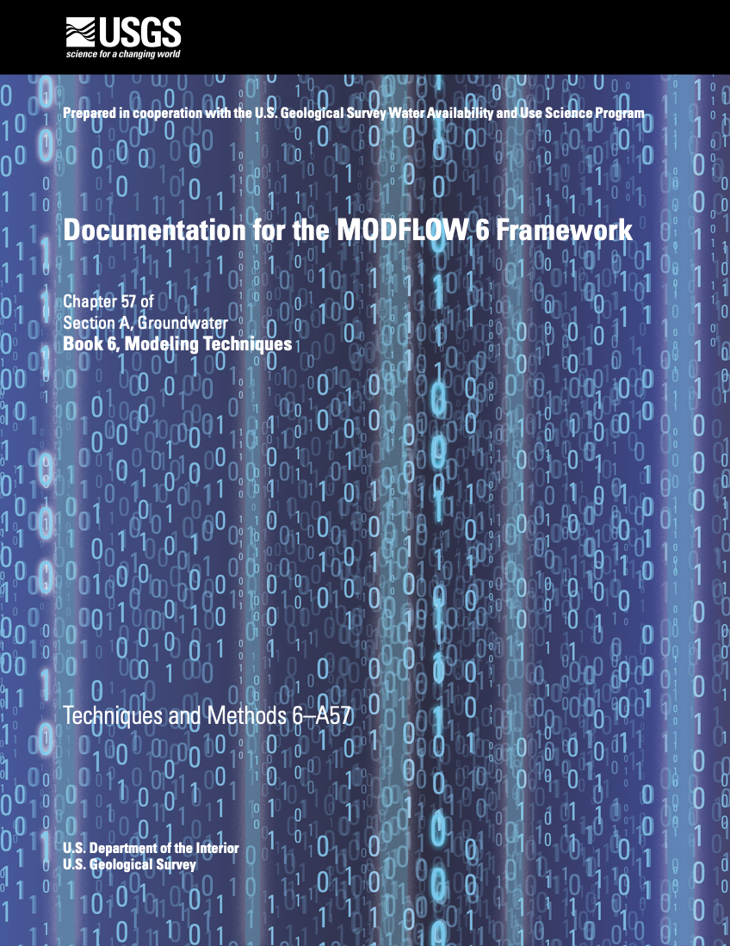
Simulation Components
Timing Module
Solutions
Models
Exchanges
Utilities

Slide 17
LGR Simulation
Simulation
Temporal Discretization
PARENT
C1
C2
GC
Iterative Model Solution

Slide 18
GWF Exchanges
Simulation
Temporal Discretization
PARENT
C1
C2
GC
Iterative Model Solution
PARENT-C1
PARENT-C2
C1-GC

Slide 19
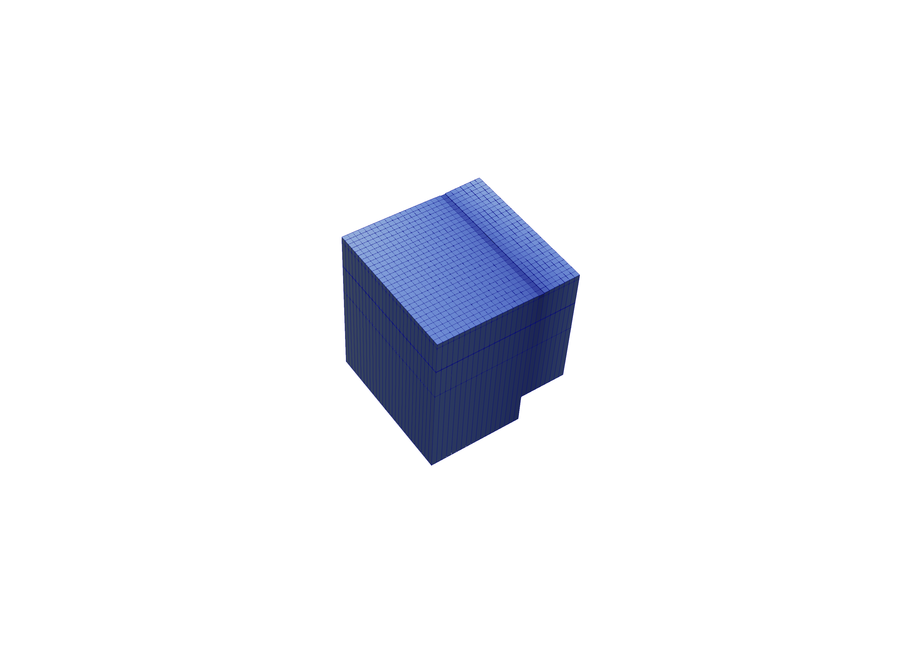
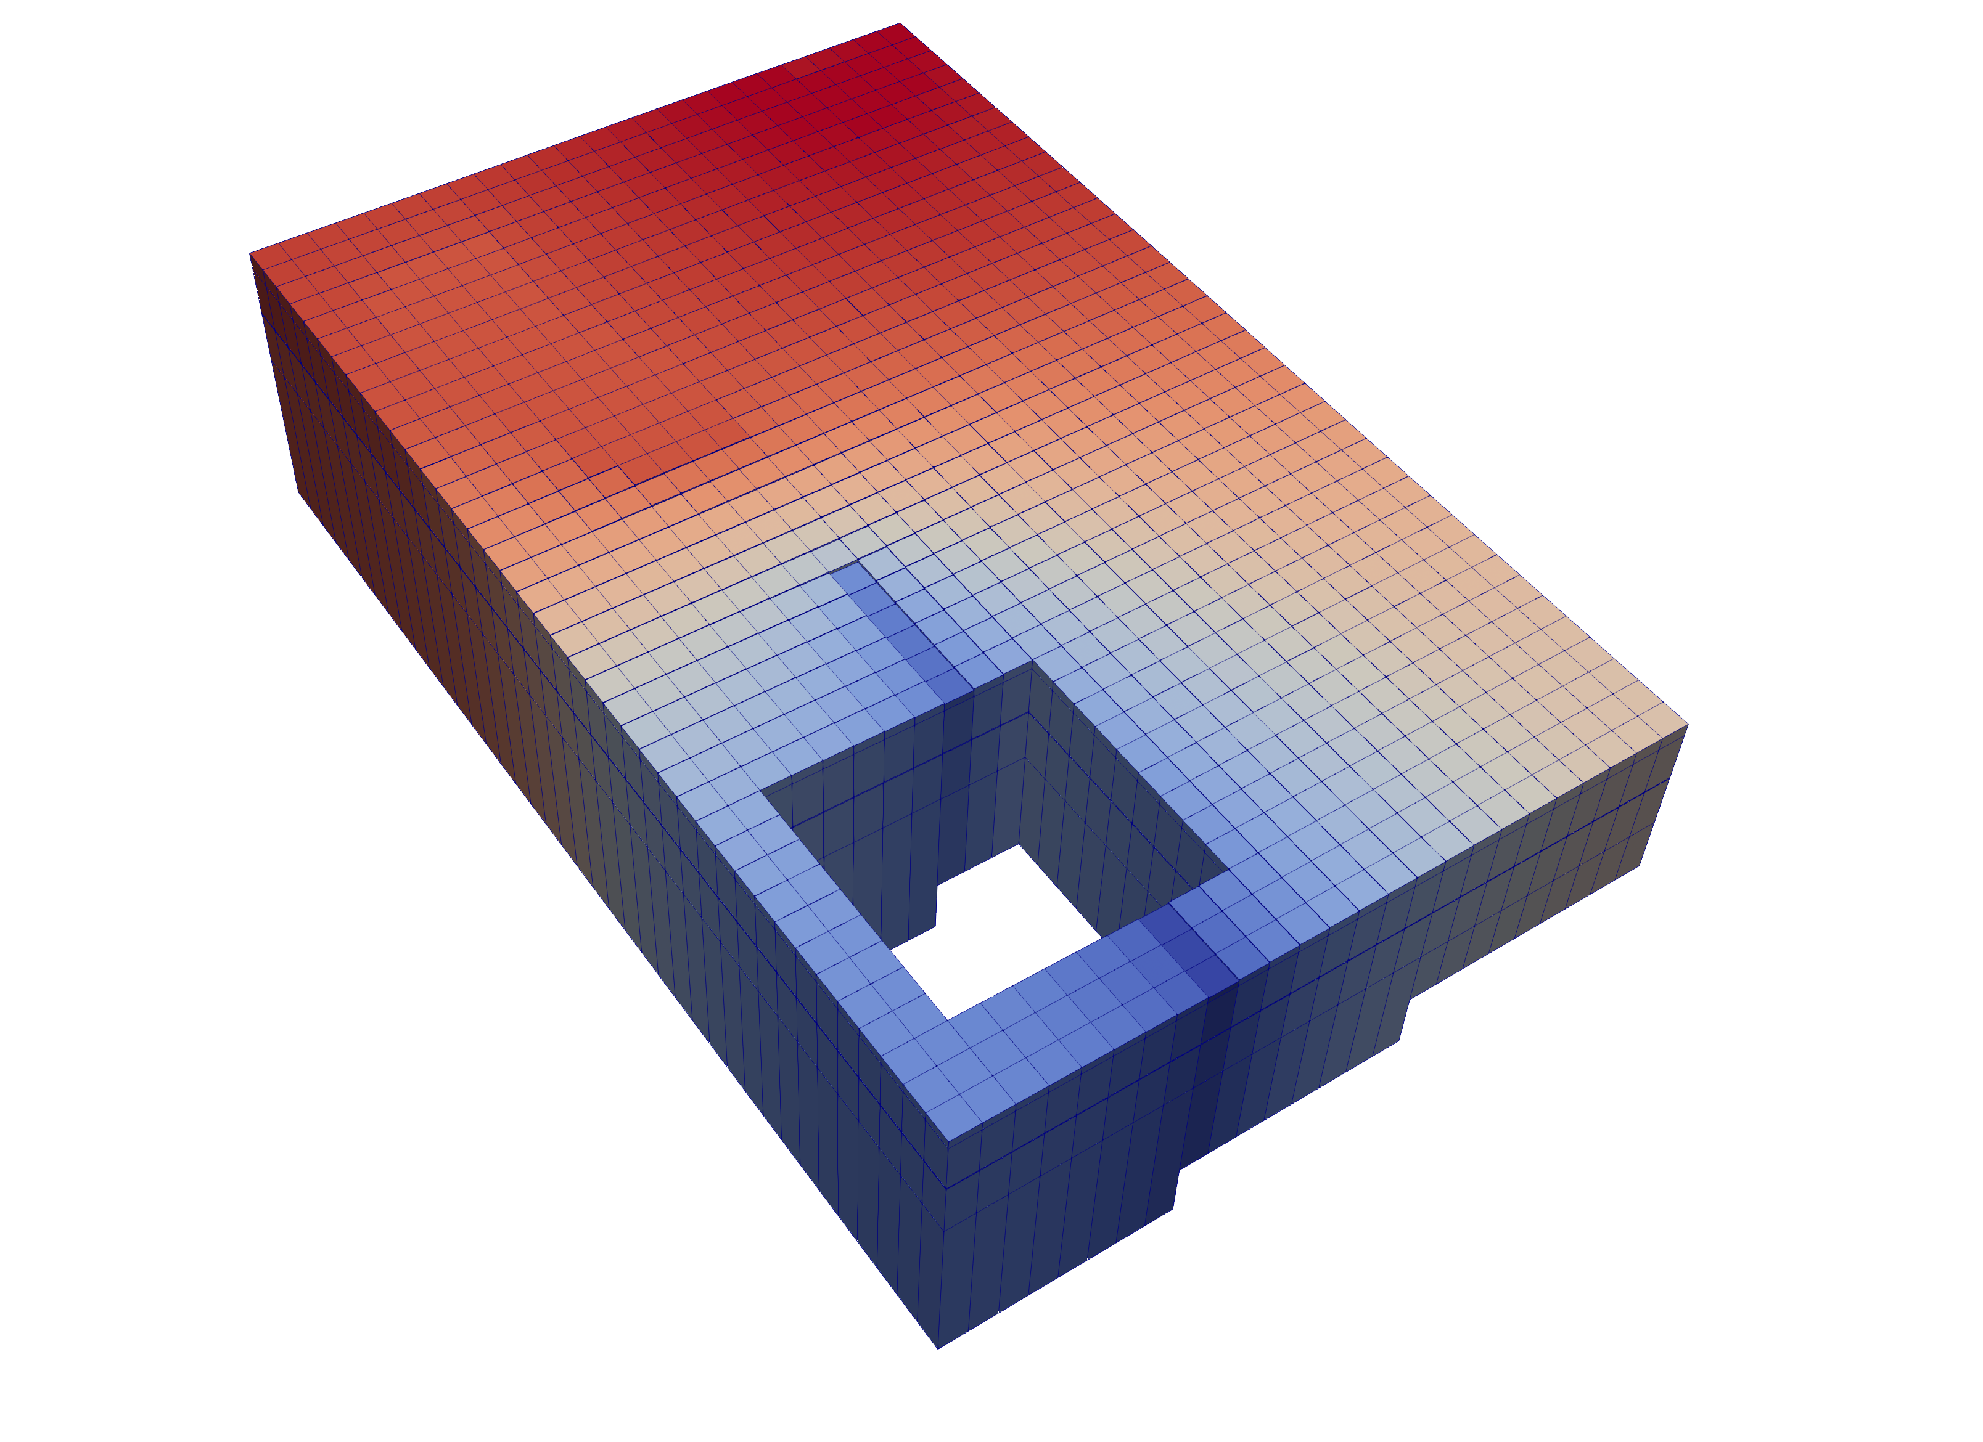
Multi-Model Coupling
Any number of models can be included in a simulation
Models coupled at matrix level
Flexibility supports coupling of parent, child, grandchild models, stacked models or adjacent models

Slide 20
Multi-Model Concept

Slide 21
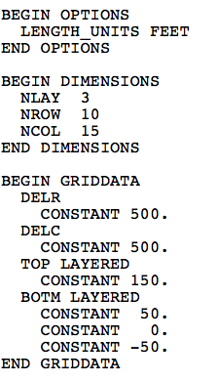
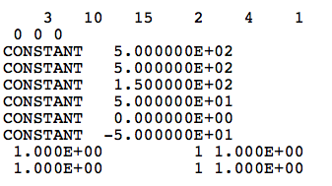
Blocks and Keywords
MODFLOW 6 DIS
MODFLOW-2005 DIS

Slide 22
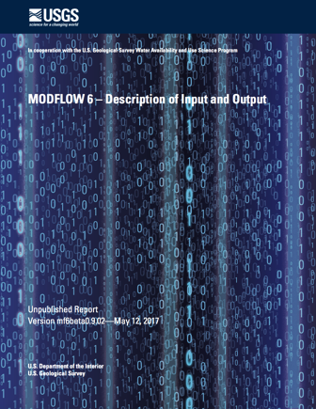
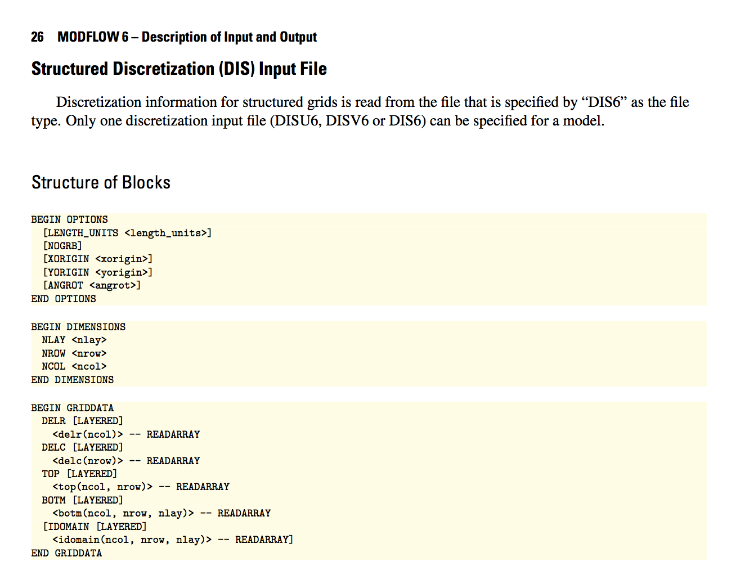
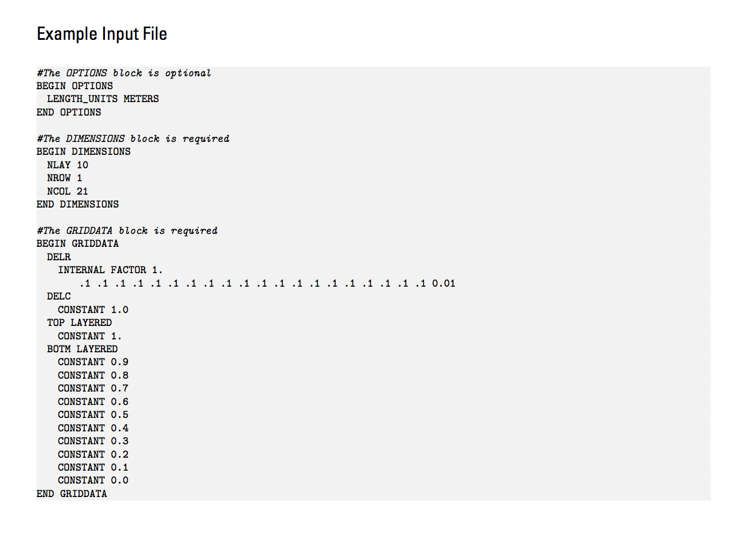
Blocks and Keywords
Notes:
Human readable
Better error trapping
Easily allows new options to be added, without breaking backward compatibility
Most blocks support OPEN/CLOSE

Slide 23
Simulation Name File
# Simulation name file
BEGIN OPTIONS
END OPTIONS
BEGIN TIMING
TDIS6 ps1.tdis
END TIMING
BEGIN MODELS
GWF6 ps1.nam ps1
END MODELS
BEGIN EXCHANGES
END EXCHANGES
BEGIN SOLUTIONGROUP 1
IMS6 ps1.ims ps1
END SOLUTIONGROUP
Required even for common case with one model
Named mfsim.nam
One simulation per folder

Slide 24
Temporal Discretization
Simulation uses the concepts of “stress periods” and “time steps”
For each stress period user specifies
PERLEN—Length of the stress period
NSTP—Number of time steps in the stress period
TSMULT—time step multiplier
For most problems, TSMULT is 1., so that each time step in PERLEN / NSTP

Slide 25
Choosing Stress Periods
Pumping
Recharge
Time
Time
Stress Periods and Time Steps
For large stress changes, may be necessary to use short time steps right after the change (use TSMULT > 1 for this)

Slide 26
Choosing Stress Periods
Pumping
Recharge
Time
Time
Stress Periods

Slide 27
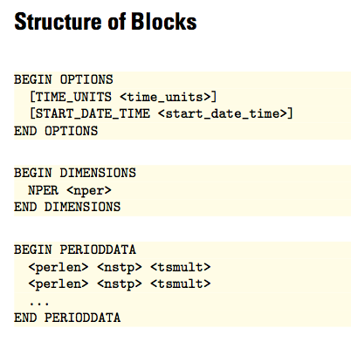
Temporal Discretization
BEGIN OPTIONS
TIME_UNITS days
END OPTIONS
BEGIN DIMENSIONS
NPER 1
END DIMENSIONS
BEGIN PERIODDATA
1.0 1 1.0
END PERIODDATA

Slide 28
Time and Length Units
Length and Time Units must be consistent for all data
For example ft and days:
Flow – cubic feet per day (ft³/d)
Hydraulic conductivity – feet per day (ft/d)
Transmissivity – square feet per day (ft²/d)
Recharge flux – feet per day (ft/d)
Time step length – days
Specific storage – per ft (1/ft)
MODFLOW lets you specify the units, but MODFLOW does not convert input data based on the units being used– the units specification is just for user information

Slide 29
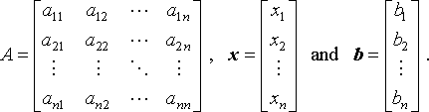
Solutions
Used to solve one or more models
The only solution available now is the Iterative Model Solution, or IMS
IMS solves the following nonlinear equation
Ax = b

Slide 30
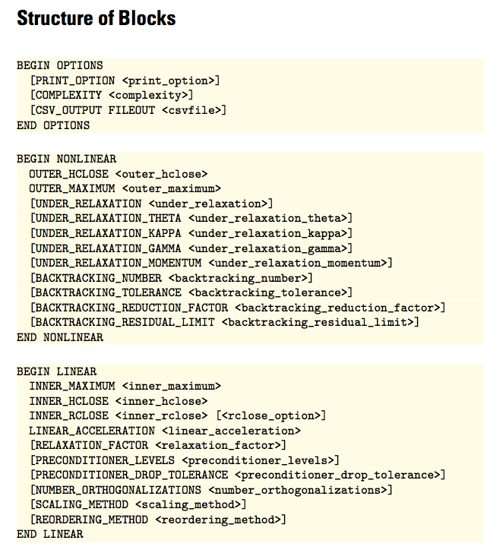
IMS Input File
BEGIN OPTIONS
COMPLEXITY SIMPLE
END OPTIONS
BEGIN NONLINEAR
END NONLINEAR
BEGIN LINEAR
END LINEAR

Slide 31
Groundwater flow (gwf) model

Slide 32
Groundwater Flow (GWF) Model
First model available in MODFLOW 6
Synthesizes capabilities in
MODFLOW-2005
MODFLOW-NWT
MODFLOW-USG
MODFLOW-LGR
MODFLOW-CDSS

Slide 33
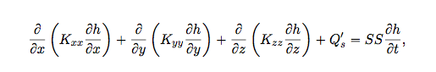
Groundwater Flow Equation

Slide 34
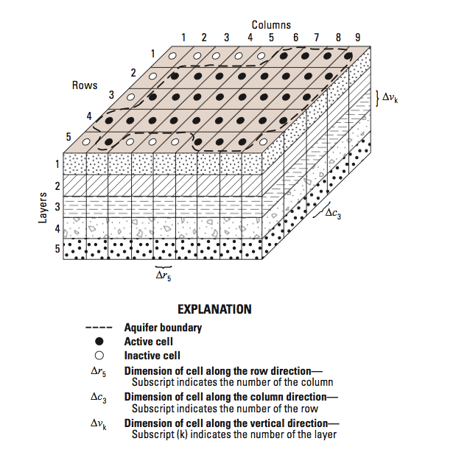
Control-Volume Finite-Difference

Slide 35
Finite-Difference Equation

Slide 36
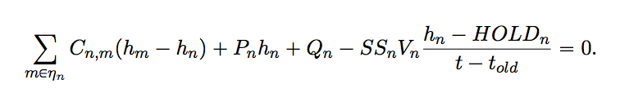
Generalized CVFD Equation

Slide 37
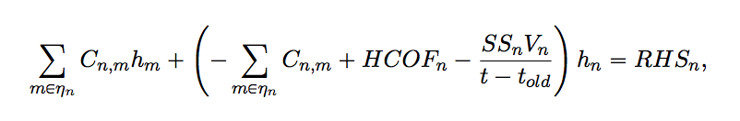
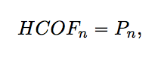
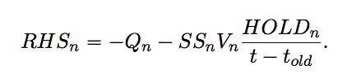
Rearranged for Solution

Slide 38
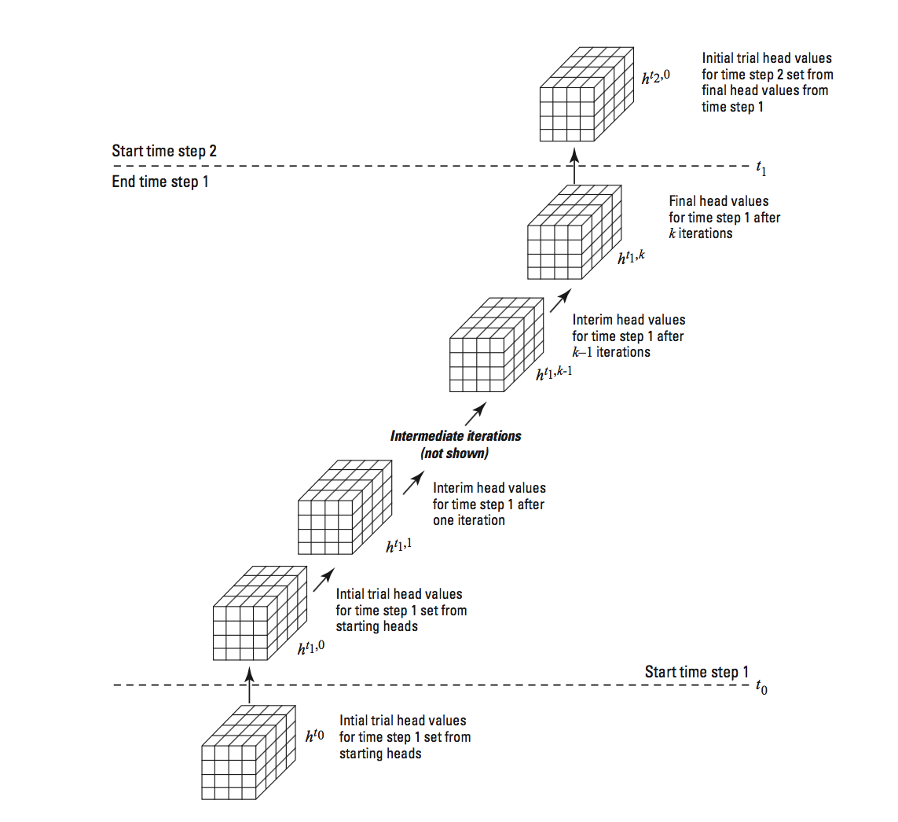
Iteration

Slide 39
Fundamental GWF Packages
Package Name | Abbreviation
Discretization | DIS
Initial Conditions | IC
Node-Property Flow | NPF
Storage | STO
Constant Head | CHD
Well | WEL
Drain | DRN
River | RIV
General-Head Boundary | GHB
Recharge | RCH
Evapotranspiration | EVT
The GWF Model in MODFLOW 6 uses the concept of a “package” to manage and activate capabilities
Packages are specified in the GWF name file

Slide 40
Groundwater Flow (GWF) Model
Discretization (DIS, DISV, DISU)
Node Property Flow (NPF)
Storage (STO)
Specified Head (CHD)
General-Head Boundary (GHB)
Stream-Flow Routing (SFR)
Initial Conditions (IC)
Horizontal Flow Barrier (HFB)
Compaction and Subsidence (CSUB)
Well (WEL)
Drain (DRN)
Lake (LAK)
Output Control (OC)
Ghost Node Correction (GNC)
Recharge (RCH)
River (RIV)
Multi-Aquifer Well (MAW)
Observations (OBS)
Buoyancy (BUY)
Evapo-transpiration (EVT)
Unsaturated Zone Flow (UZF)
Viscosity (VSC)
Water Mover
(MVR)
Data Input
Internal Flow
Internal Flow
Hydrologic Stress
Advanced Stress Package

Slide 41
Example GWF Name File
BEGIN OPTIONS
END OPTIONS
BEGIN PACKAGES
DIS6 ps1.dis
IC6 ps1.ic
NPF6 ps1.npf
OC6 ps2.oc
CHD6 ps1.chd
END PACKAGES

Slide 42
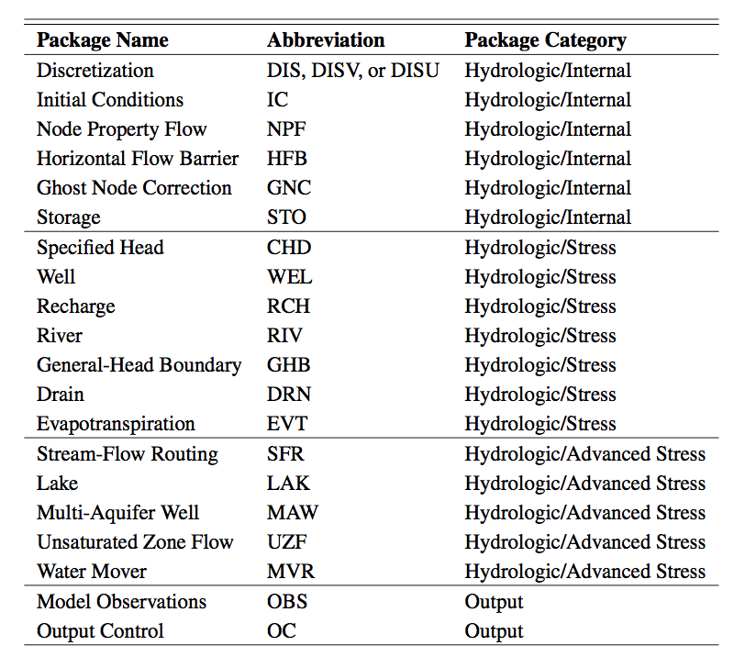
All GWF Packages

Slide 43
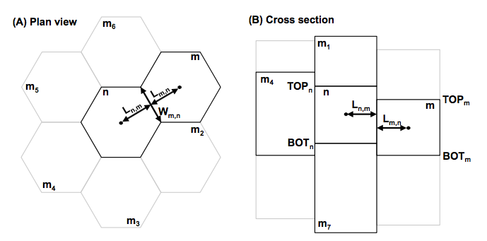
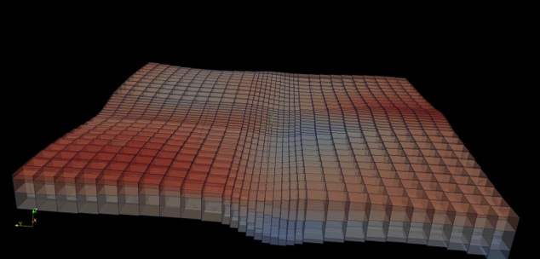
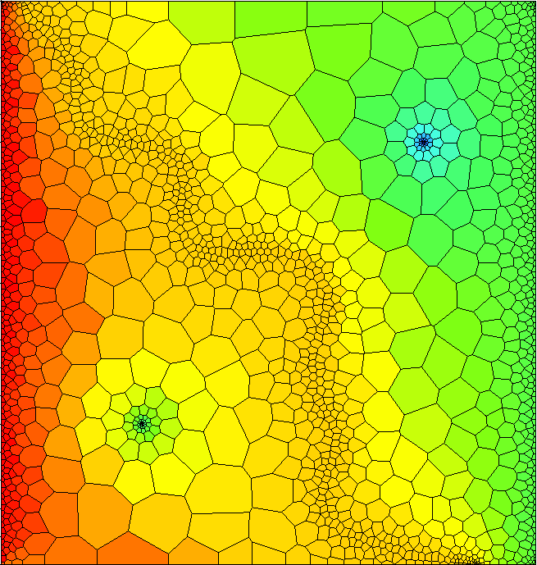
Spatial Discretization
Three ways to enter grid
DIS – regular MODFLOW grid
DISV – discretization by vertices
DISU – fully unstructured

Slide 44
Discretization (DIS) Package
“Regular MODFLOW grid”
Consists of layers, rows, and columns
Top and bottoms can have variable elevations

Slide 45
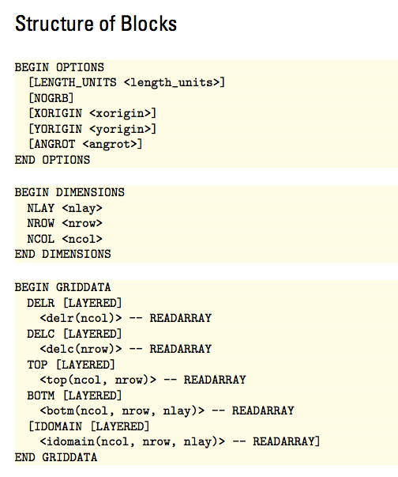
DIS Input File

Slide 46
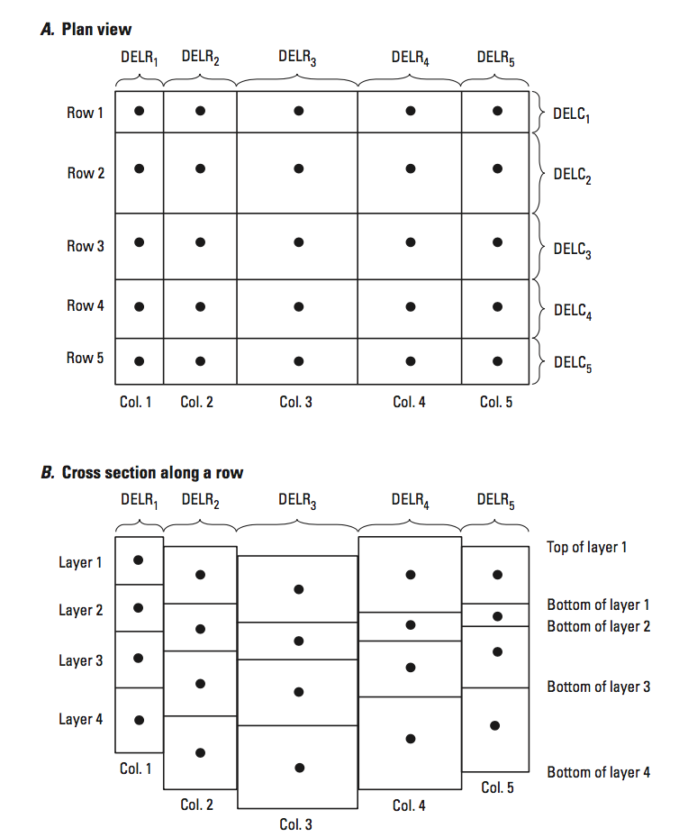
DIS Input File

Slide 47
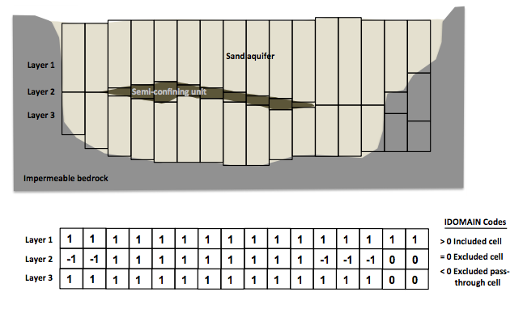
DIS Input File

Slide 48
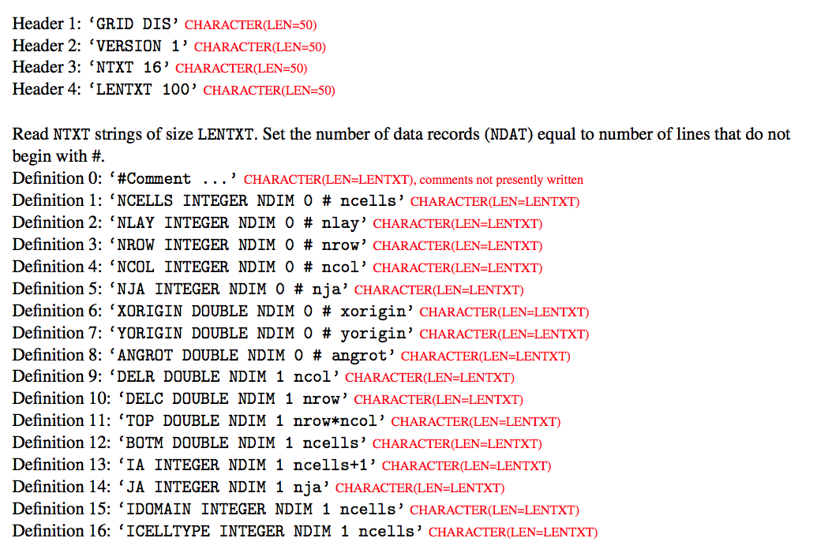
DIS Input File
Binary Grid File

Slide 49
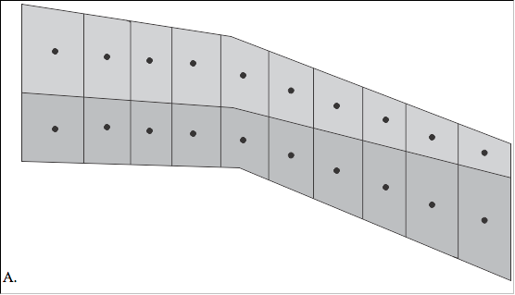
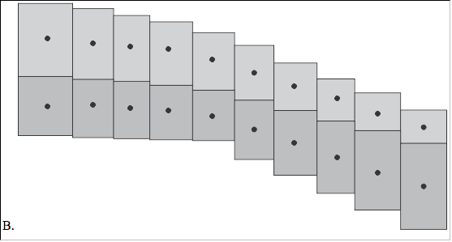
Which representation is correct?

Slide 50
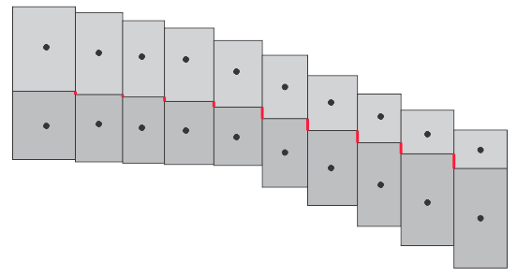
Caution with Vertical Offsets
MODFLOW does not connect cells on adjacent sides of the red line.

Slide 51
Example DIS Input File
BEGIN OPTIONS
LENGTH_UNITS FEET
END OPTIONS
BEGIN DIMENSIONS
NLAY 3
NROW 21
NCOL 20
END DIMENSIONS
BEGIN GRIDDATA
DELR
CONSTANT 500.
DELC
CONSTANT 500.
TOP
CONSTANT 350.
BOTM LAYERED
CONSTANT 220.
CONSTANT 200.
CONSTANT 0.
END GRIDDATA

Slide 52
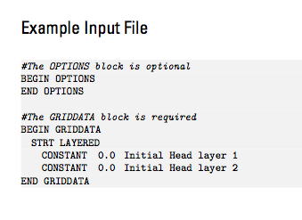
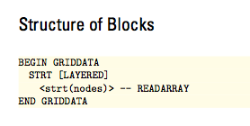
Initial Conditions
Specify starting heads
A head value below cell bottom elevation will start the cell as dry
Always required, even for steady-state simulations

Slide 53
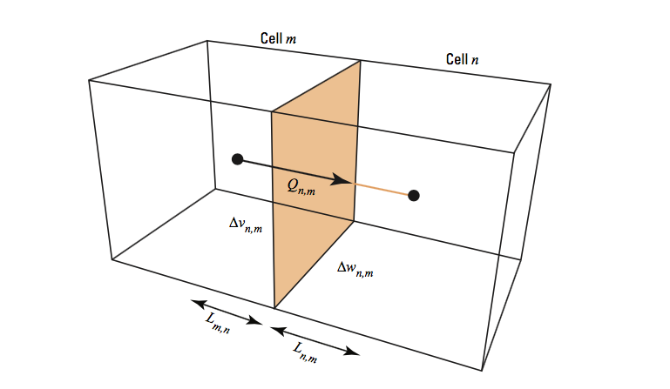
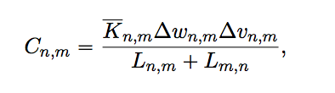
Node Property Flow (NPF) Package
Calculates conductance between cells
Manages cell wetting and drying
Can invoke an optional XT3D formulation

Slide 54
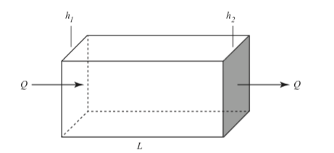



Conductance Equations

Slide 55



Prisms in Series

Slide 56


Horizontal Conductance

Slide 57

NPF Input File

Slide 58
NPF Input File
ICELLTYPE=0: cell is treated as confined for conductance calculations
ICELLTYPE=1: cell converts between confined and unconfined depending on head

Slide 59


NPF Input File
K
K22
K33

Slide 60


NPF Input File
Conductivity ellipsoid (for any cell) can be rotated around its three axes

Slide 61



NPF Input File
XT3D Option more robust, but computationally expensive

Slide 62

NPF Input File
MODFLOW rewetting can be used to reactivate cells that have gone dry
Rewetting is no longer recommended. Use Newton-Raphson instead!

Slide 63


NPF Input File
Vertical conductance calculation: DEFAULT (most stable)

Slide 64

NPF Input File
Vertical conductance calculation: VARIABLECV

Slide 65

NPF Input File
Vertical conductance calculation: VARIABLECV and DEWATERED

Slide 66

NPF Input File
Vertical flow calculation: PERCHED

Slide 67

Constant Head (CHD) Package
Fixes the head in a cell at the user-prescribed value. This value change from one time step to the next.
Should be used with caution because there is no limit to the volume of water that can be lost to or provided from constant head cells.

Slide 68

CHD Input File

Slide 69
CHD Input File
MAXBOUND is the maximum number of constant head cells that will be active in any stress period.

Slide 70

CHD Input File
List of constant head cells. These cells will remain as constant head cells until another PERIOD block is encountered.

Slide 71
CHD Input File
Auxiliary variables

Slide 72
CHD Input File

Slide 73
CHD Input File
PRINT_INPUT: echo input to the listing file
PRINT_FLOWS: write calculated CHD flows to the listing file
SAVE_FLOWS: write calculated CHD flows to budget file

Slide 74
CHD Input File
Variables shown in blue can be represented using time series. Values are interpolated each time step from a user-provided time series record.

Slide 75
Example CHD Input File
BEGIN OPTIONS
PRINT_INPUT
PRINT_FLOWS
SAVE_FLOWS
END OPTIONS
BEGIN DIMENSIONS
MAXBOUND 42
END DIMENSIONS
BEGIN PERIOD 1
# canal
1 1 1 330.0
1 2 1 330.0
1 3 1 330.0
1 4 1 330.0
...
# river
1 1 20 320.0
1 2 20 320.0
1 3 20 320.0
...
END PERIOD

